Slide 1
Mediator Pattern
By: Marco Zangana and Aidan Regan

Slide 2
What is mediator pattern
Similar to the observer pattern
All communications go through mediator
Singular point of dependency for each class
Mediator can observe many things and the communication goes through each class
Notes:
The mediator pattern is similar to the observer pattern in many ways. They both have 1 or more classes looking at other classes and receiving event calls. However, the mediator pattern differs in the way that it sends and receives events from not only 1 class but to many classes. In the mediator pattern all communication between classes goes through the mediator. These mediator classes become the sole point of dependency for the program and see each class that needs some form of communication.

Slide 3
Pros and Cons of mediator pattern
Pros
Cons
Open/closed design
Highly reusable components
Reduced Coupling
Easier to comprehend and maintain
Singular point of communications
Can easily become a “god class”
The mediator interactions may become confusion if it is very complex
Notes:
Pros: The mediator pattern has an open/closed design whereas more mediators can be added with little to no change in the rest of the code. Each component is reusable and will overall reduce coupling. Due to all of the communications going through a singular point, the program as a whole is easier to comprehend and maintain.
Cons: Also due to all communications going through one singular class, this class can easily become what is known as a god class. A god class is a class that is essentially all knowing and all powerful. It is similar to a "do it" class but on a higher level. This can also make the mediator class very confusing and complex if the scale grows to an enormous size.

Slide 4
Industrybaby Mediator
Real World Example
Chat rooms
Discord
Slack
Teams
Notes:
In the industry, the mediator pattern is used in chats or forums. Some examples would be Discord, Slack, and Teams. These chat rooms could be using the mediator pattern whereas the sender class sends a message to the receiver class but using the mediator in between to make the communication between multiple people easier.

Slide 5
Final Project
Battleship
5 ships
Player should choose where to put ships and choose which grids to fire on
The board should show red for a hit or white for a miss
Player should be able to play against an ai opponent with alternating turns
When all of a given player ships are sunken, the opponent wins
Notes:
Our final project will be a game most if not all of us know about. That game being battleship. To give a brief explanation of battleship for those who don't know or have forgotten, there are 5 ships per player. 1 ship with a size of 2, 2 ships with a size of 3, 1 ship with a size of 4, and 1 ship with a size of 5. Each of these ships would be placed somewhere on the board and their locations hidden from the other player. Each player will take turns selecting a coordinate to fire at. If there is a ship on the given coordinate then the player is told that it is a hit. If the player is smart enough to continue firing in the nearby areas and hits all of the given ship's locations, then that ship is sunken. This continues until 1 player has sunken all of the other player's ships. In our implementation of this game we will be using the mediator pattern to communicate between the board and the ships. Each time a ship is hit, it will communicate through the mediator to let the board know to mark that area as a hit. It will also notify the mediator each time a miss occurs to then let the board know to mark the given area as a miss.

Slide 6
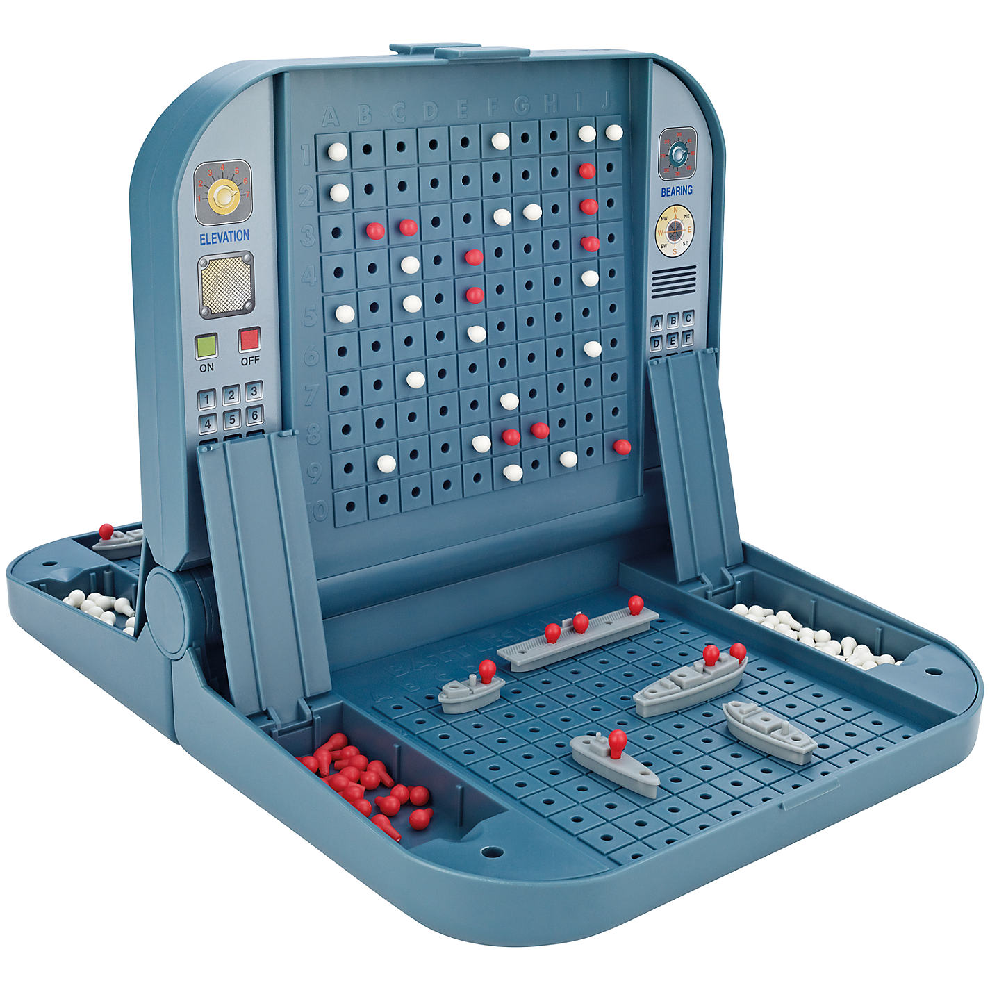
Notes:
Just so you can get some idea of what it might look like we have included a picture of the physical version of the game. As you can see there are 5 ships and red/white pins.

Slide 7
Mediator Pattern Functionality
Will act as the link between the board and the ships
A domain class will act and have an action, the mediator pattern will take in the action and use one of its sub class mediators to complete the action
Once the action has been completed, the sub class communicates with the interface and the interfaces manipulates the receiving domain class
Ship talks with mediator to say it has taken a hit
Mediator talks with sub classes then sub classes talk back to the mediator then to the board
Notes:
In ou

Slide 8
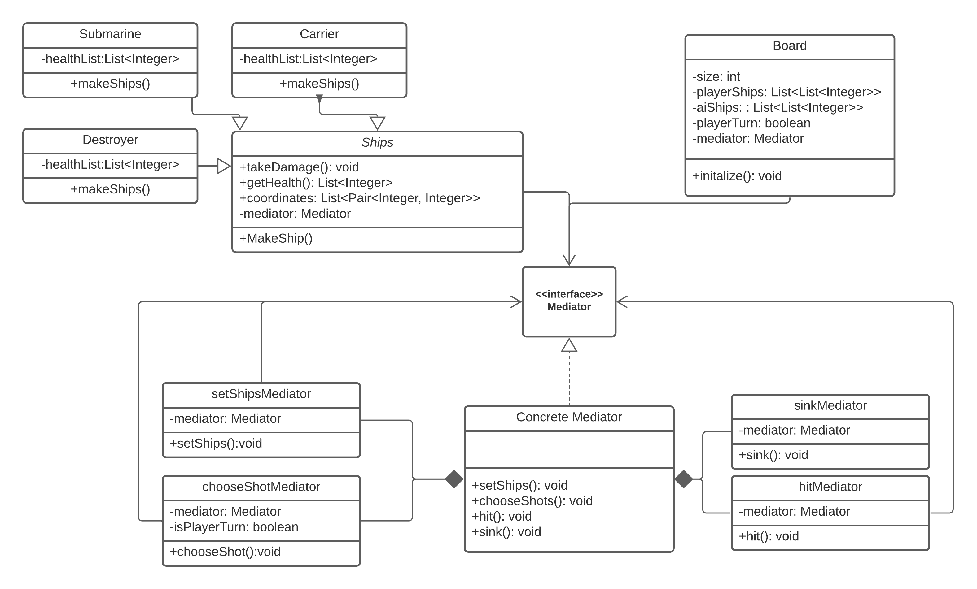
UML

Slide 9
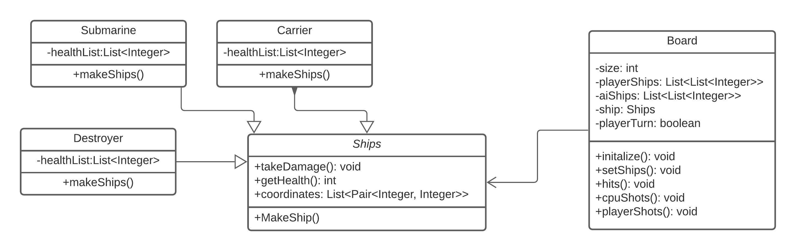
UML Diagram without Mediator Pattern

Slide 10
Things to Know About the Mediator Pattern
In layman’s terms: it is a more complicated observer pattern
All actions are communicated through the mediator interface
The interface goes through a concrete mediator
The concrete mediator has the action methods and uses subclasses to perform the action
Once the action is completed, the subclass connects back to the interface
The interface interacts with the domain class

